Slide 1
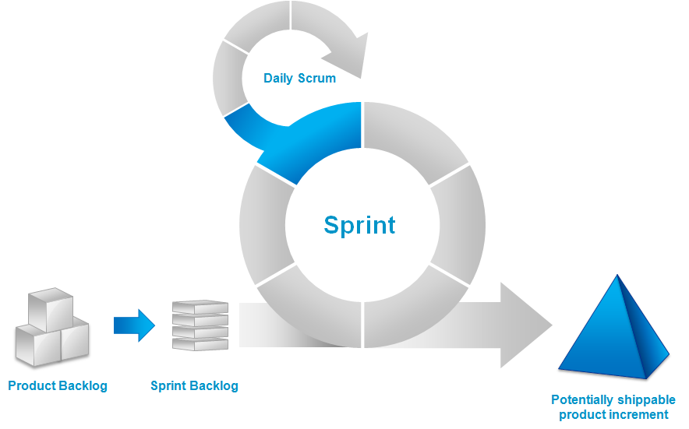
SCRUM
Aman, Xander, Mark, Mitchel

Slide 2
Inhoudsopgave
SCRUM
Product backlog
Sprint backlog
Sprint
Daily scrum
Potentially shippable product

Slide 3
SCRUM
Agile
Rollen

Slide 4
Product backlog
Agile
Rollen

Slide 5
Sprint backlog

Slide 6
Sprint

Slide 7
Daily scrum

Slide 8
Potentially shippable product

